Slide 1
Dev Workshop 101

Slide 2
From scratch
Setting up your dev environment…

Slide 3
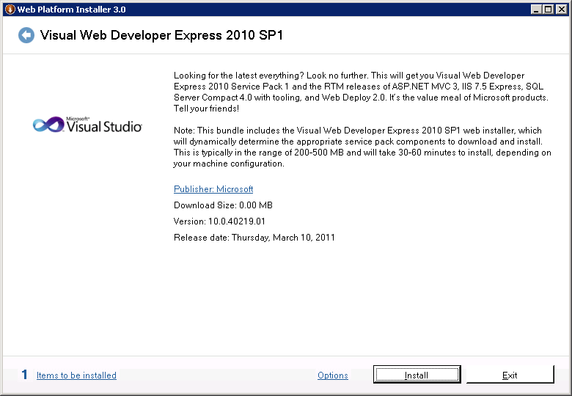
http://bit.ly/WebDevExpress2010
Use Web PI 3.0
Install “Visual Web Developer Express 2010 SP1”
You’ll get it all…but it will take a LONG time.
Notes:
When it installs SQL Server Express leave the default “Mixed Mode Authentication” and select a good SA password (don’t forget it).

Slide 4
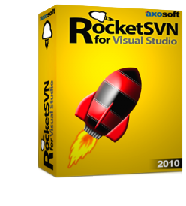
http://bit.ly/WebDevExpress2010
Express does not have a plug-in system so you can’t do SVN (like RocketSVN) inside Visual Studio.
So we’ll use TortoiseSVN later on.
Notes:
When it installs SQL Server Express leave the default “Mixed Mode Authentication” and select a good SA password (don’t forget it).

Slide 5
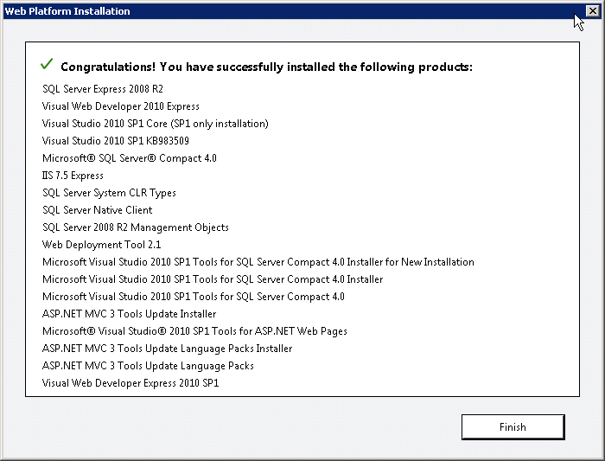
One click install!
Yeah, it took a while… but that’s a ton of stuff

Slide 6
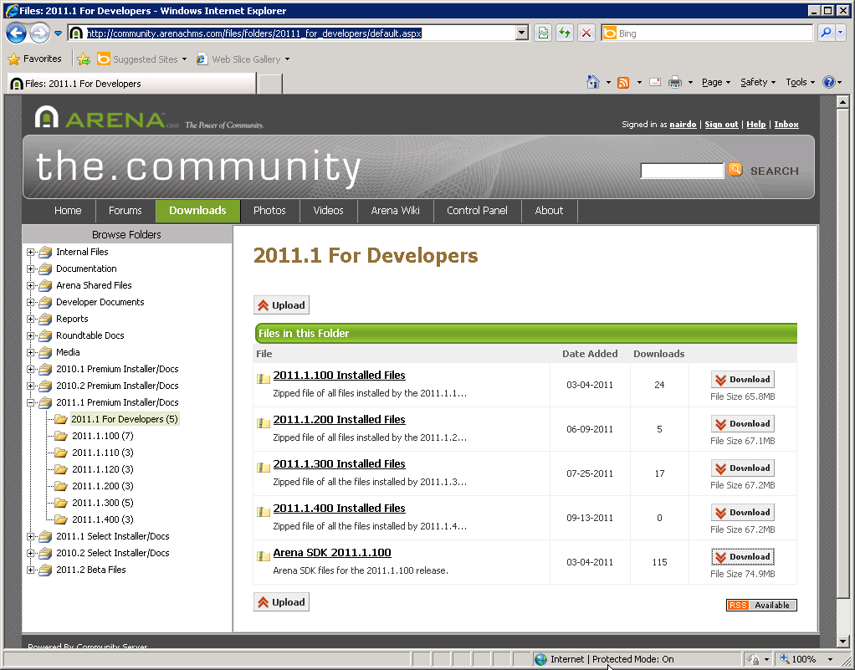
http://bit.ly/ArenaSDK2011-1
Download the Arena SDK
By convention, unzip to folder C:\ArenaSDK\2011.1\base

Slide 7
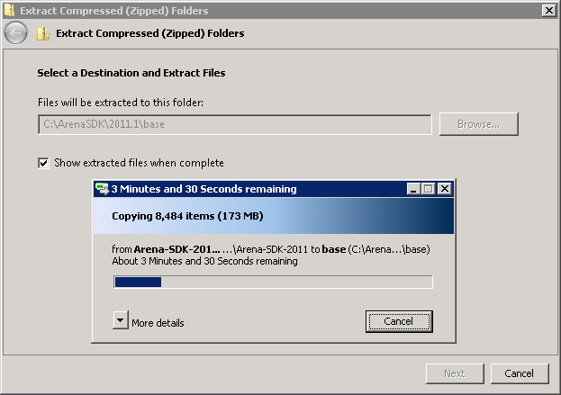

Slide 8
Read the README.txt
Just because you always should!
And because there’s important info in there such as…
The remainder of the steps you need to complete

Slide 9
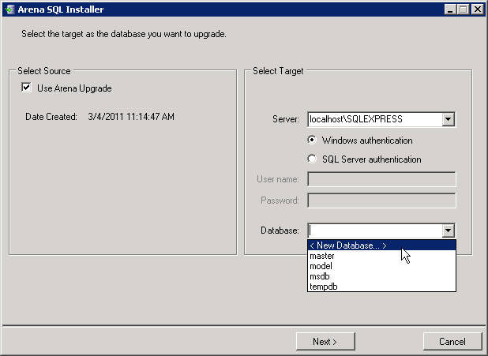
SQLInstaller no reports.bat
You may need to change localhost to “localhost\SQLEXPRESS”
Then select <New Database…>

Slide 10
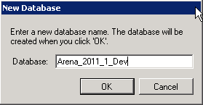
Convention is key
Again, by convention*, use the name Arena_2011_1_Dev
Click Next >, then “No” when asked if you want to define a specific user…
*See David Turner’s 2009 presentation “SDK Moving Target”

Slide 11
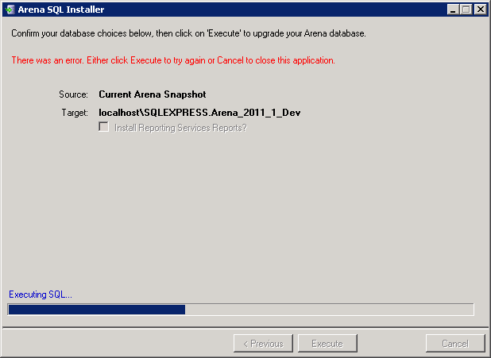
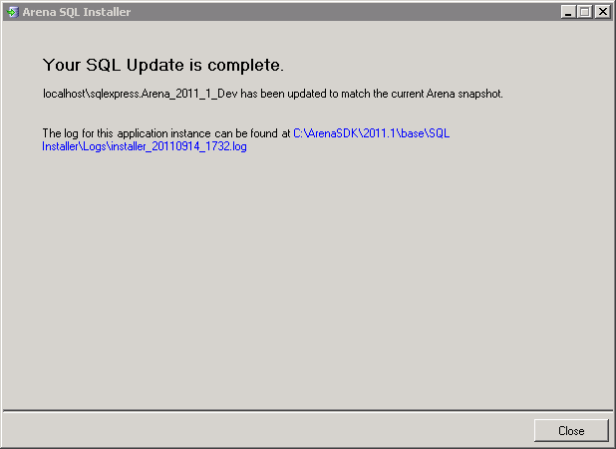
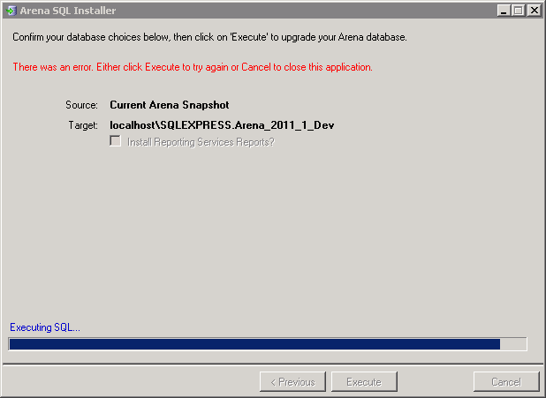
Notes:
No problem afterall…

Slide 12
Back to README.txt
Step 2 – open solution file
Web\Arena.sln
If asked, choose Visual Web Developer Express 2010
Click Next > to step through the conversion wizard. (No need to create a backup before converting)
Then get ready to always say “Yes” to this message:

Slide 13
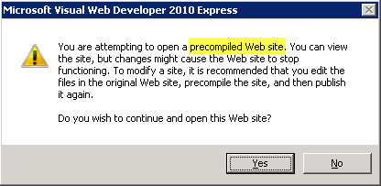
Yes!
Because we don’t have the source code for most of Arena – it’s in their DLLs.

Slide 14
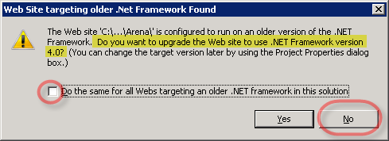
No! (But I wish!)
Arena is not compatible with .NET 4.0 yet.

Slide 15
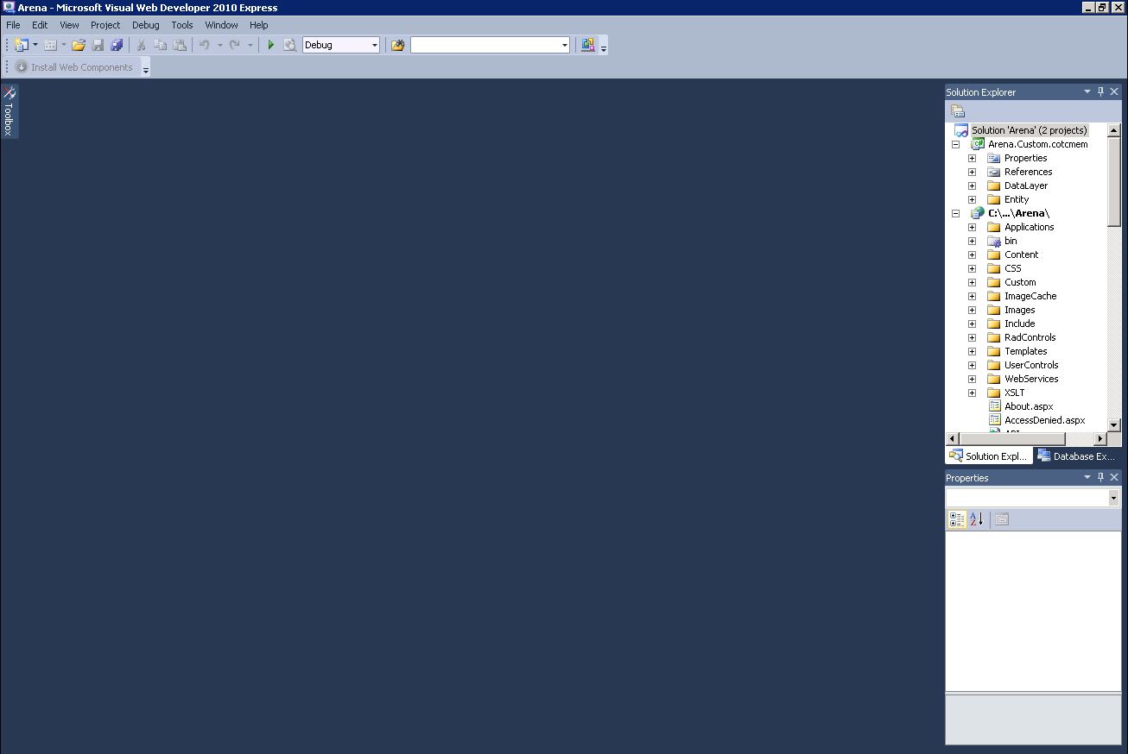
Ahhhh, you made it!
…almost – just a few more steps

Slide 16
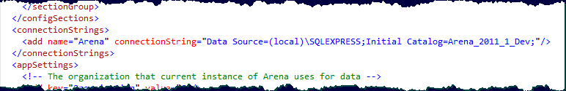
Back to README.txt
Step 3 – open web.config file
Change connectionString to "Data Source=(local)\SQLEXPRESS;Initial Catalog=Arena_2011_1_Dev;"

Slide 17
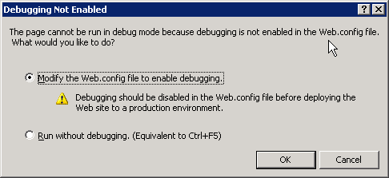
Save & Debug!
F5 to debug
Answer “OK” :

Slide 18
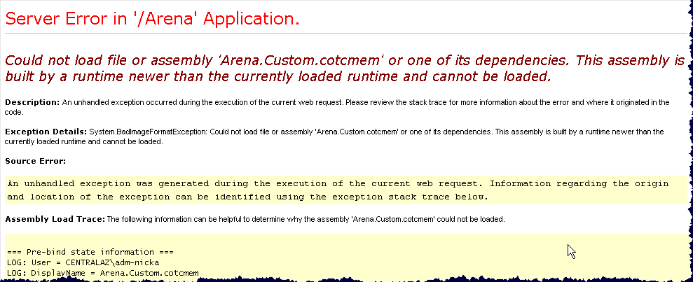
Arena “Install”
Step through form and…oops, I spoke to soon:

Slide 19
Your First Problem
Be resourceful and fix the problem
*Hint* – read what the error says
[Presenter Note – let them sweat it out.]

Slide 20
Solved?
Once you’ve resolved that…
F5 to debug/run
…and

Slide 21
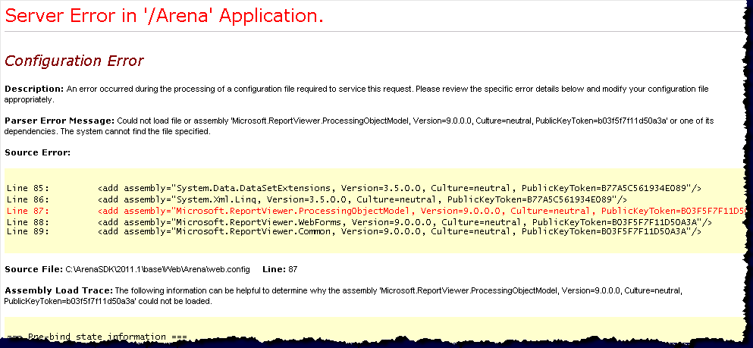
Your Second Problem
Dependencies
[Presenter Note – let them sweat it out again.]
Notes:
Is “ReportViewer” installed… or the correct version of the assembly?

Slide 22
http://bit.ly/MS-ReportViewer2008
http://www.microsoft.com/download/en/details.aspx?id=6576 (v9.00.21022.08 from 11/20/2007) is not to be confused with this: http://www.microsoft.com/download/en/details.aspx?id=577 (v9.0 from 9/9/2008)
ReportViewer Download
Run to install
Step through wizard/setup
Restart Visual Studio (GAC issues)

Slide 23


Slide 24
Answers
A) Arena wants their newest community developers to have a rough start.
B) It’s a test?
C) It builds resiliency?
D) Only C, D & E are correct
E) All of the above

Slide 25
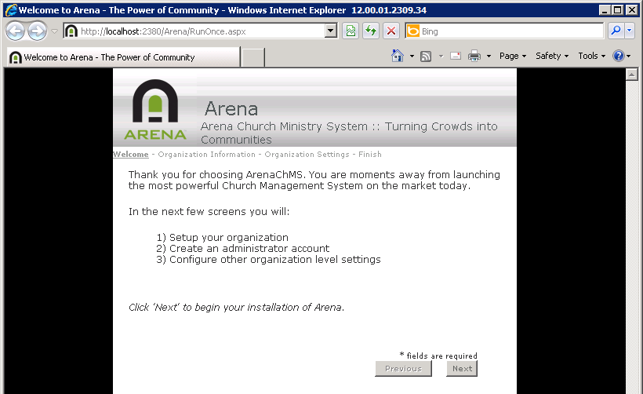
Proceed with Arena Setup

Slide 26
Source Control
Sharing and keeping your stuff with…

Slide 27
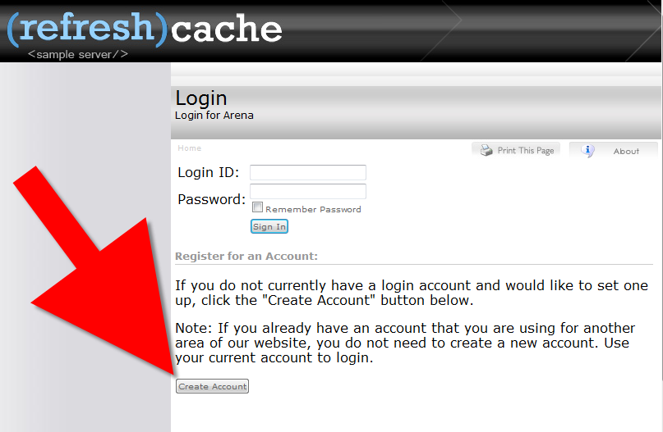
Create Account @ RefreshCache
http://arena.refreshcache.com

Slide 28
SubVersioN Basics
We’ll just show you a few basic things to get you started.
SVN Checkout
SVN Update
SVN Commit…
You can read more about SVN later
We’ll be using the Redmine.RefreshCache.com server

Slide 29
ACMD Guide
Arena Custom Module Development
Included in your C:\ArenaSDK\RefreshCache\QAChecklist\trunk
Read it
Needs updating or overhaul
But… still best source for standardized arena custom module development
conventions, naming conventions, etc.

Slide 30
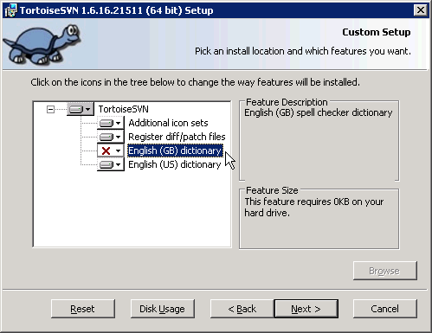
http://tortoisesvn.net/downloads.html
If using VS Express download TortoiseSVN
Run the installer

Slide 31
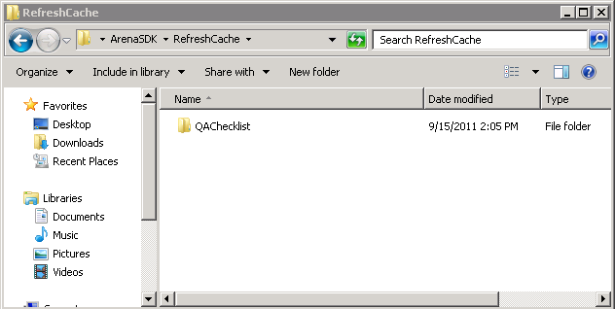
SVN Checkout
Create folder: C:\ArenaSDK\RefreshCache
Then create one under it for a demo project called “QAChecklist”

Slide 32
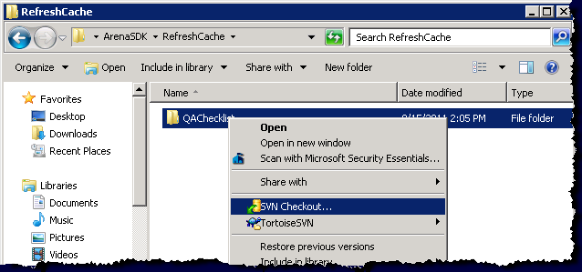
SVN Checkout
Then right-click and select “SVN Checkout…”

Slide 33
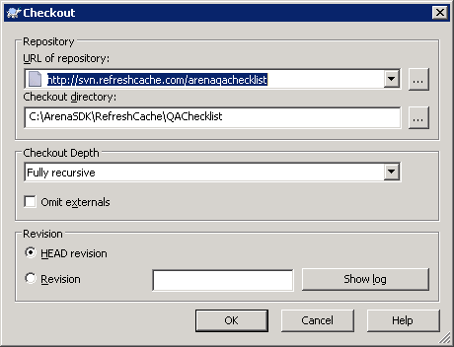
URL of Repository
http://svn.refreshcache.com/arenaqachecklist

Slide 34
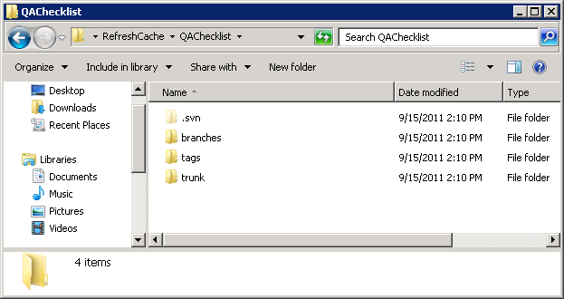
Now You’ve Got Code

Slide 35
What is Trunk, Branch, Tag
Trunk would be the main body of development, originating from the start of the project until the present.
Branch will be a copy of code derived from a certain point in the trunk that is used for applying major changes to the code while preserving the integrity of the code in the trunk. If the major changes work according to plan, they are usually merged back into the trunk.
Tag will be a point in time on the trunk or a branch that you wish to preserve. The two main reasons for preservation would be that either this is a major release of the software, whether alpha, beta, RC or RTM, or this is the most stable point of the software before major revisions on the trunk were applied.
The most voted/favored definitions as seen at StackOverflow

Slide 36
References
SVN Manual http://svnbook.red-bean.com/
Rocket SVN (SVN client for Visual Studio) http://www.axosoft.com/rocketsvn
Tortise SVN (SVN client for Windows shell extension) http://tortoisesvn.tigris.org/

